Slide 1

Question Answering System: JARDIS
Week 4: Memory Network
Zakaria
김준식 류영표 손규빈
유재준 이현호 정유진

Slide 2
Goal – Study – Plan
Question answering system
for specific domain
Stack Overflow?
조선왕조실록?
Movie script?
Travel information?
한글?

Slide 3
Goal – Study – Plan
W1: Word embedding | Word2Vec(Skip-gram, CBOW), Gensim, GloVe
W2: Sequence embedding | RNN, GRU, LSTM, Seq2Seq
W3: Question Answering | Question Answering Using Deep Learning, Deep Averaging Network(+video), Question Answering with Subgraph Embeddings
W4: Memory Network | Memory Networks(+video), End-To-End Memory Networks, Dynamic Memory Networks for Visual and Textual Question Answering
Goal setting, Dataset | Not yet
QA Implementation | Not yet

Slide 4
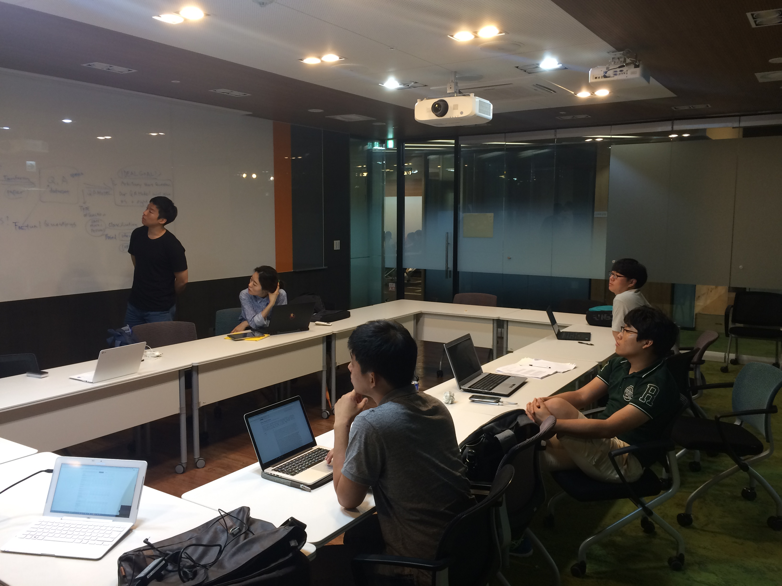
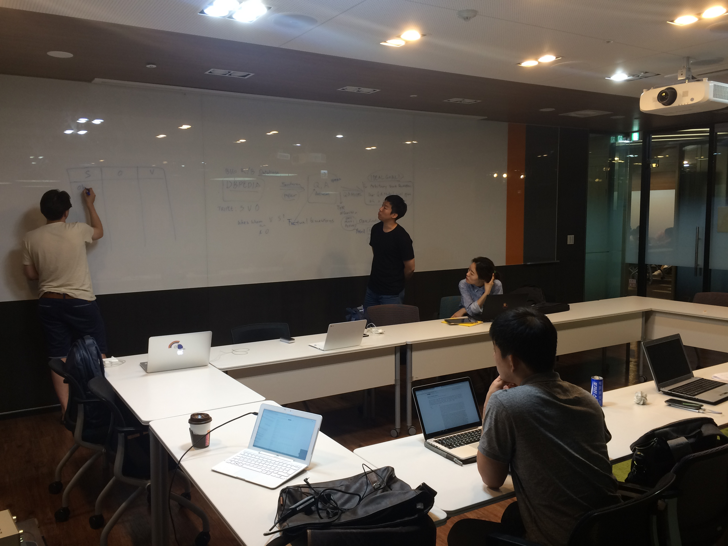
Goal – Study – Plan

Slide 5
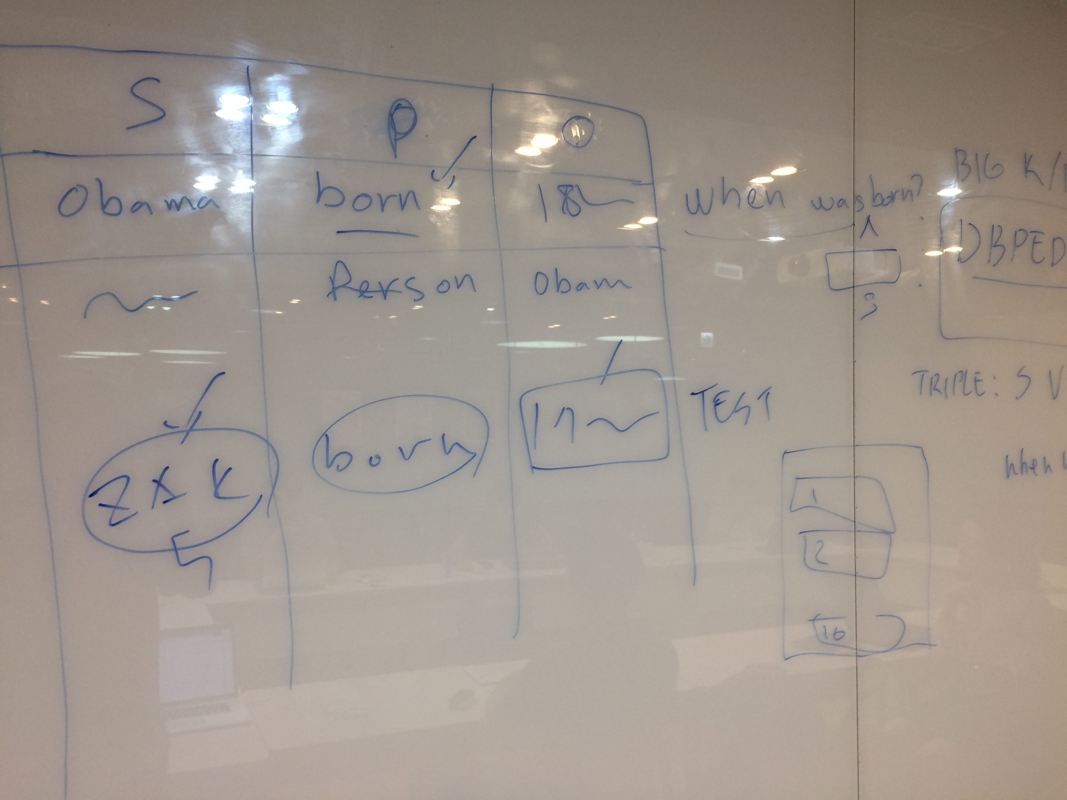
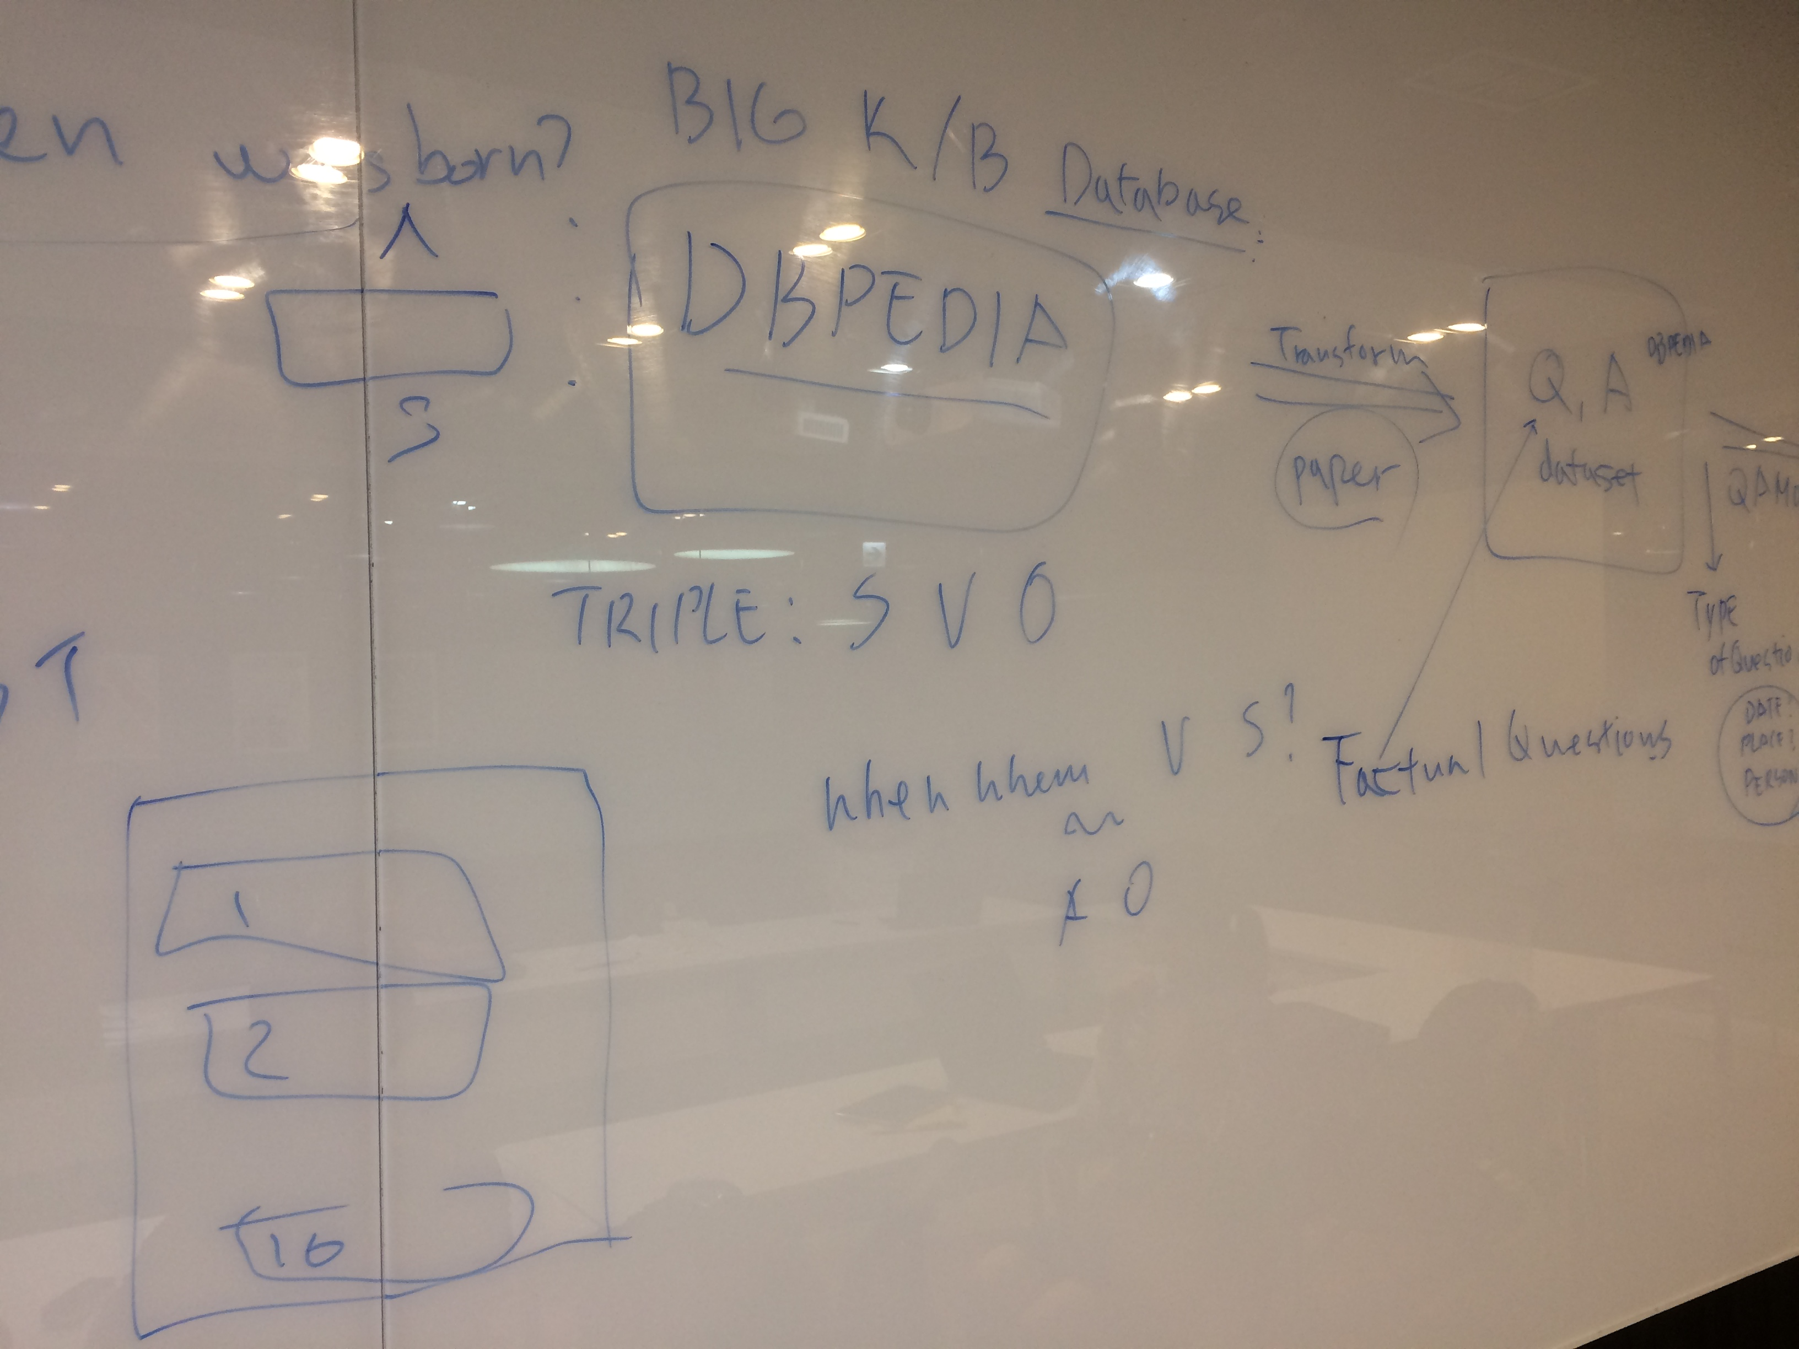
Goal – Study – Plan
Triples
Knowledge Base

Slide 6
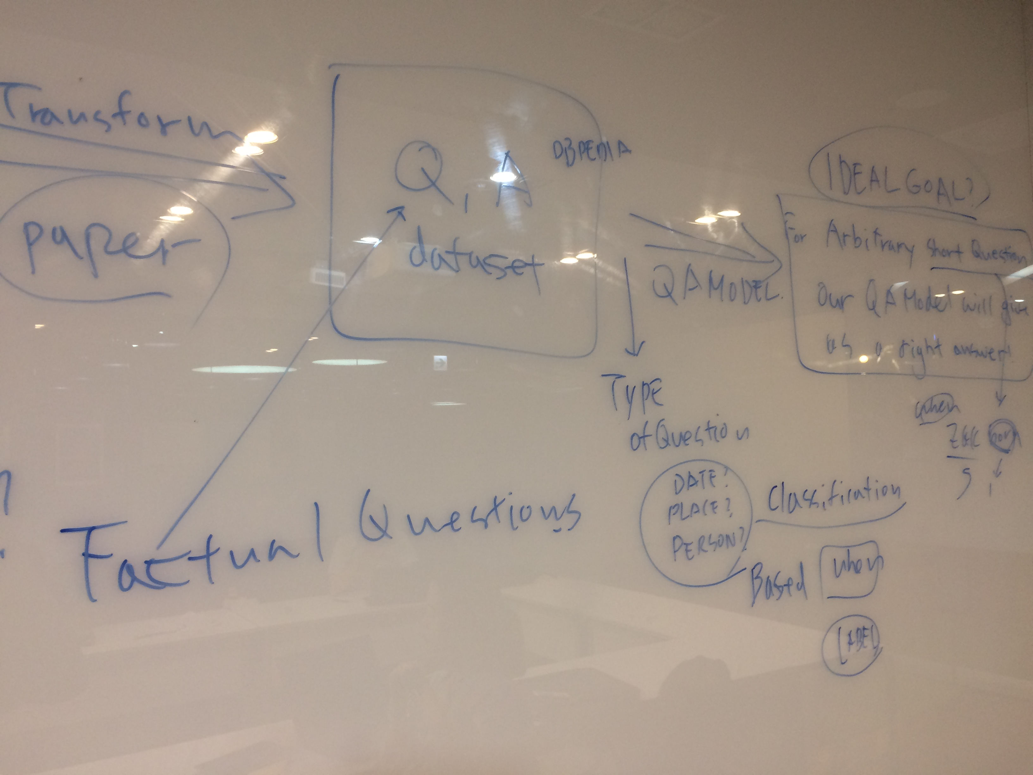
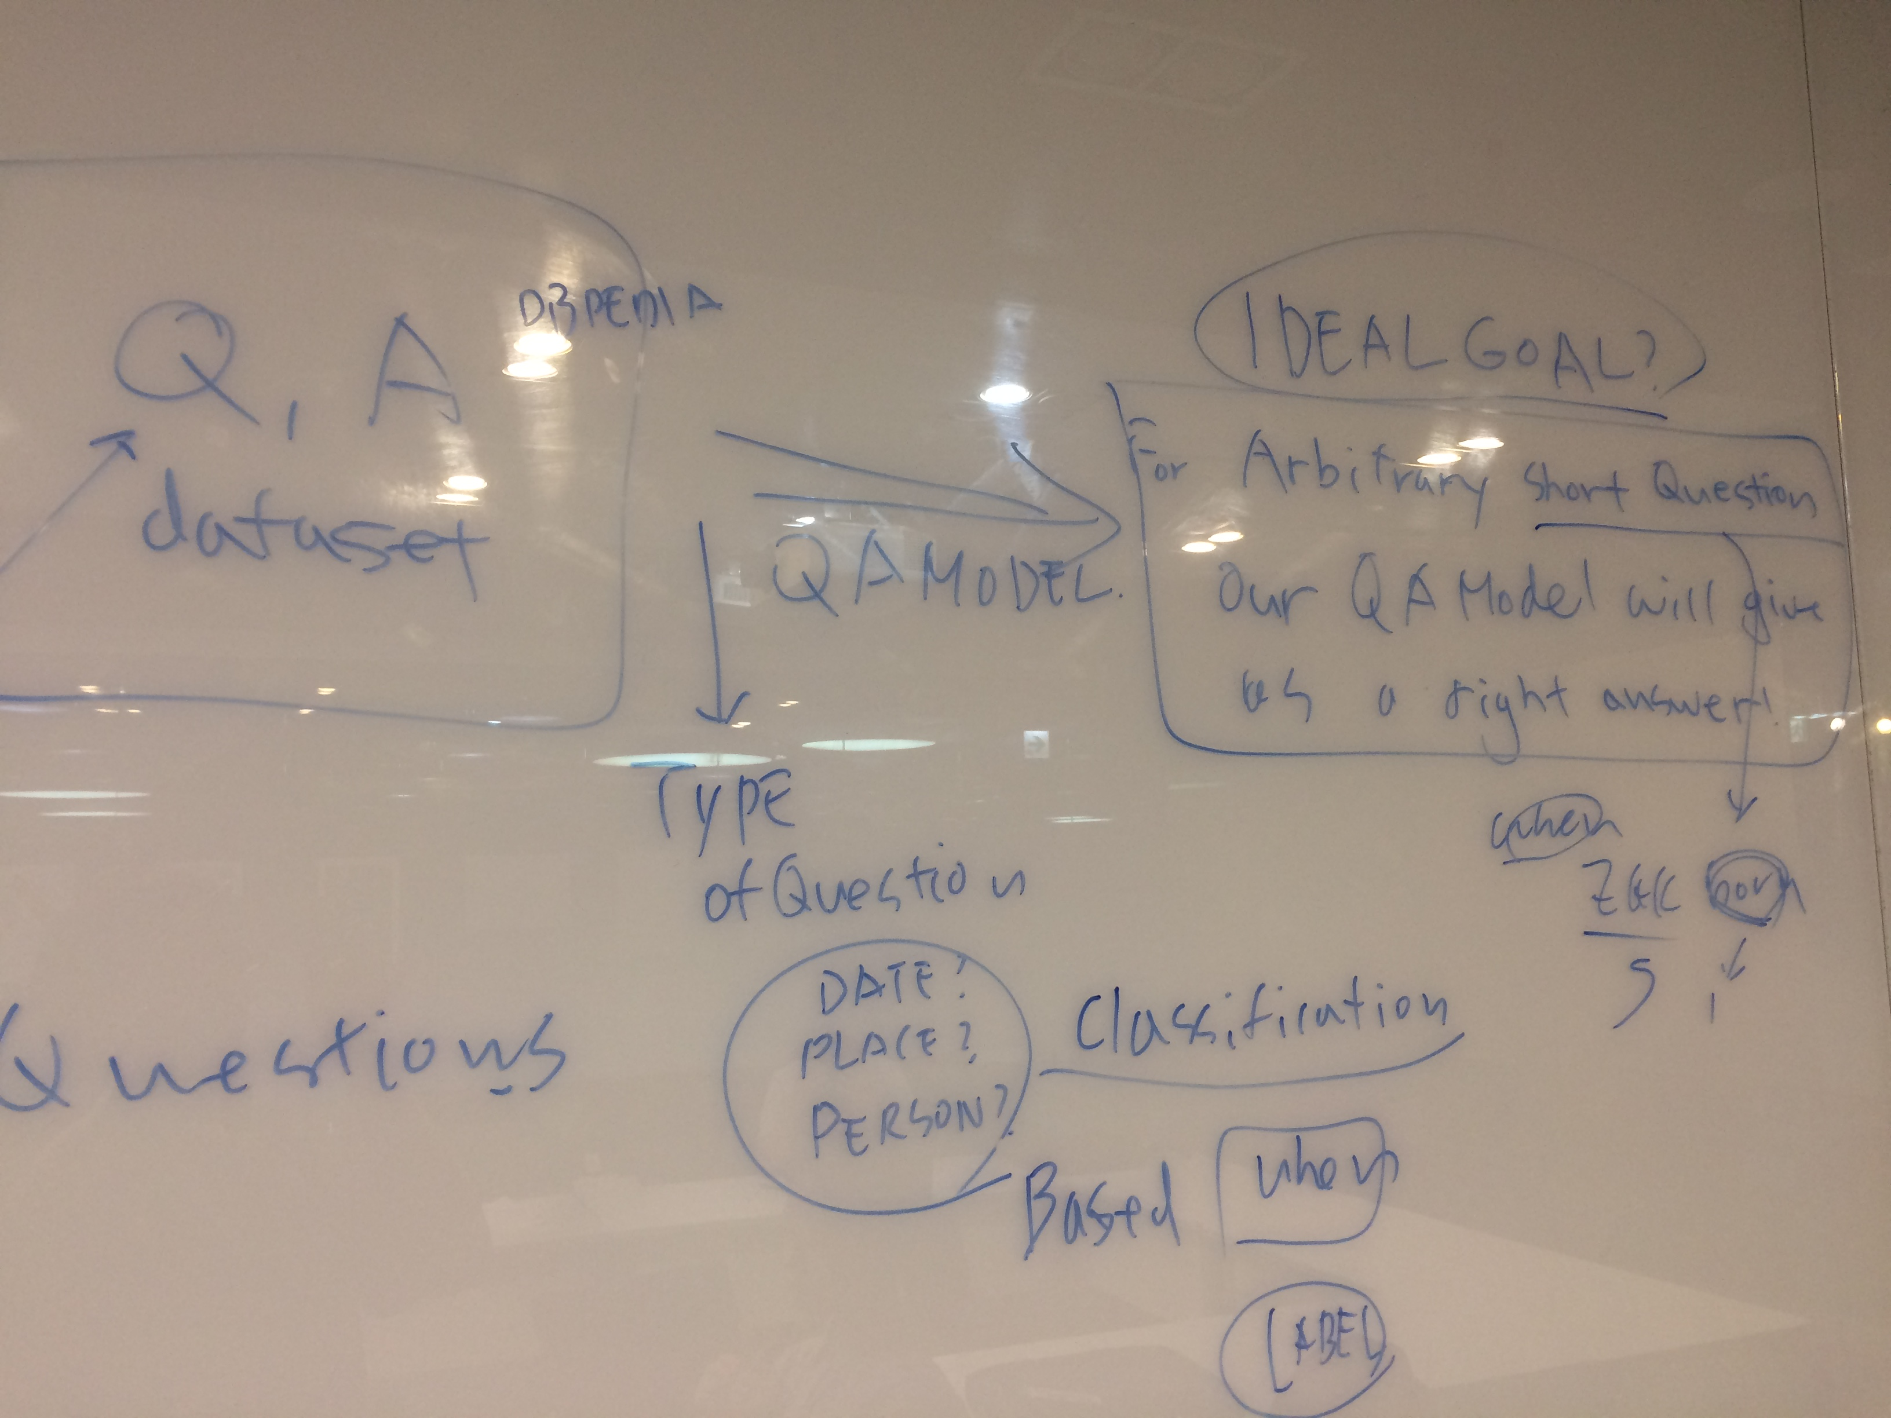
Goal – Study – Plan
QA System
Output
Model
Classification

Slide 7
Goal – Study – Plan
"Knowledge Base Completion via Search-Based Question Answering" by B.West et al 2014 (WWW)

Slide 8
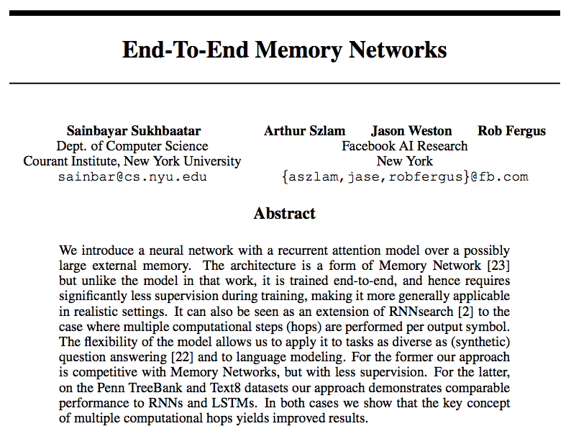
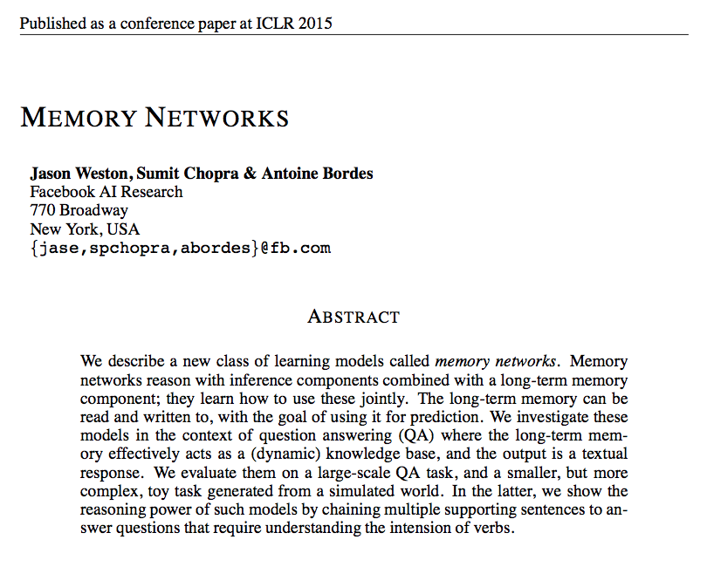
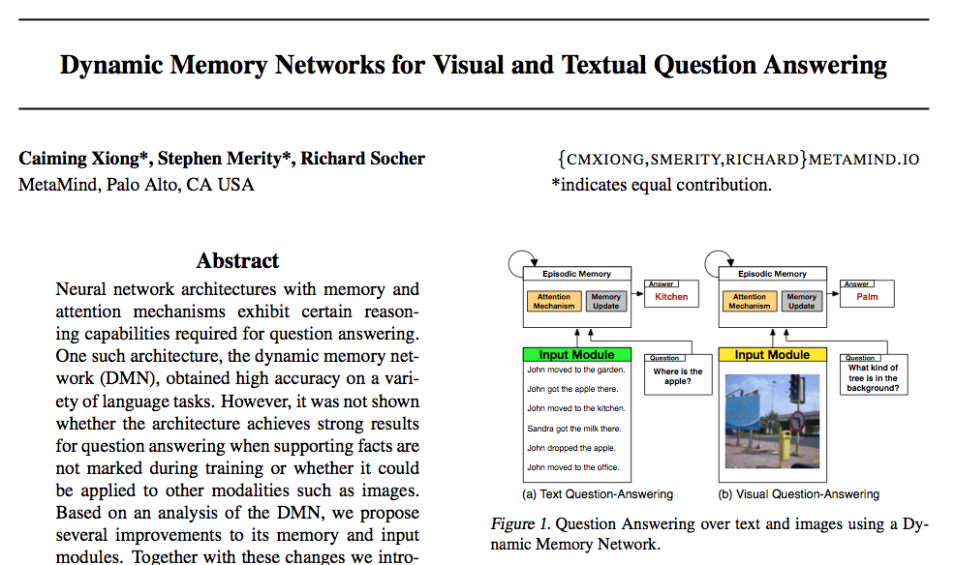
Goal – Study – Plan
Memory Network
youtu.be/Xumy3Yjq4zk

Slide 9
Goal – Study – Plan
Memory Network
Background
Knowledge Base data is HUGE!
Long-term memory is required
To remember previous dialog (short- and long-term), and respond
Most ML has limited memory(RNN, LSTM)

Slide 10
Goal – Study – Plan

Slide 11
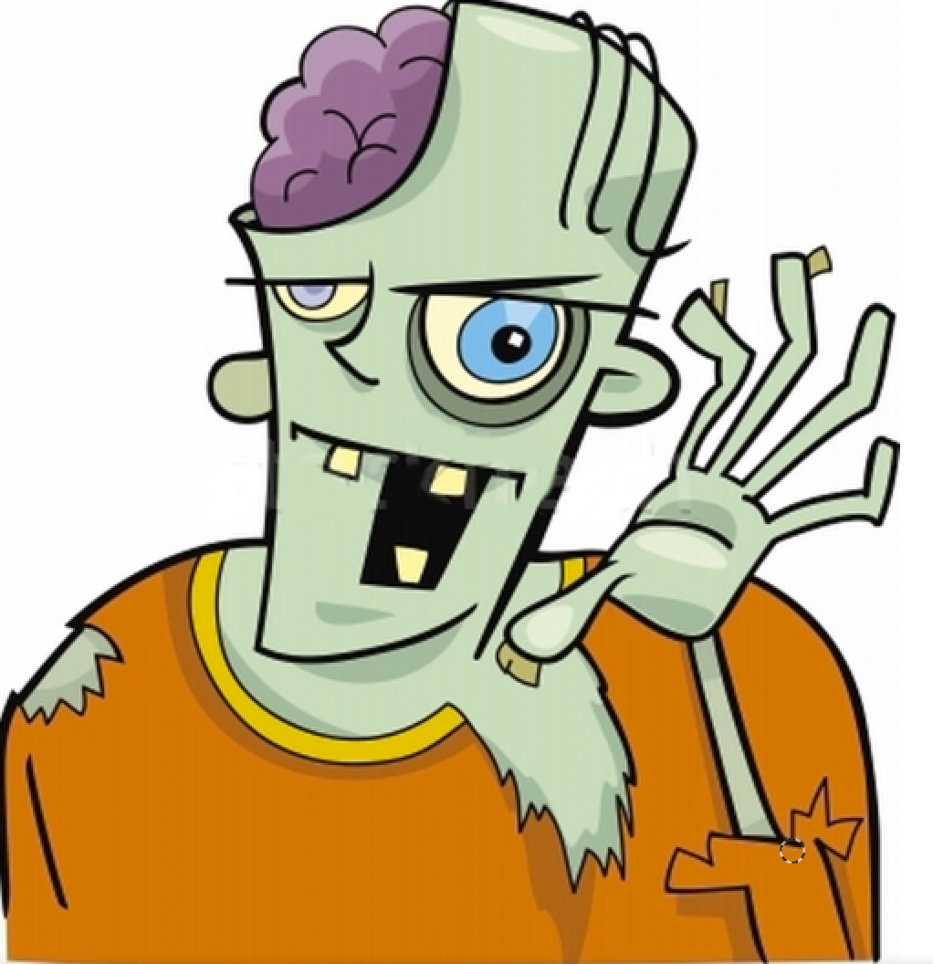
Goal – Study – Plan
Memory Network
MemNNs have four component networks.
I (Input feature map)
convert incoming data to the internal feature representation.
G (Generalization)
update memories given new input.
O (Output)
produce new output (in feature representation space) given the memories.
R (Response)
convert output O into a response seen by the outside world.

Slide 12
Goal – Study – Plan
Memory Network
MemNNs have four component networks.
I (Input feature map)
converts to bag-of-word-embeddings x.
G (Generalization)
stores x in next available slot mN.
O (Output) : Loops over all memories k=1 or 2 times:
1st loop max: finds best match mi with x.
2nd loop max: finds best match mJ with (x, mi).
The output o is represented with (x, mi, mJ).
R (Response)
Ranks all words in the dictionary given o and returns best single word. (OR: use a full RNN here)

Slide 13
Goal – Study – Plan
Memory Network
[Figure by Saina Sukhbaatar]

Slide 14
Goal – Study – Plan
Memory Network
Representation of inputs and memories could use all kinds of encodings
bag of words, RNN style reading at word or character level, etc.
Different possibilities for output module
e.g. multi-class classifier or uses an RNN to output sentences.
If the memory is huge (e.g. Wikipedia) we need to organize the memories.
Hash the memories to store in buckets (topics).
Then, memory addressing and reading doesn't operate on all memories.
If the memory is full, there could be a way of removing one it thinks is most useless
“forgets” somehow.
That would require a scoring function of the utility of each memory..

Slide 15
Goal – Study – Plan
Memory Network
John is in the playground.
Bob is in the office.
John picked up the football.
Bob went to the kitchen.
Where is the football? A: playground
SUPPORTING FACT
SUPPORTING FACT

Slide 16
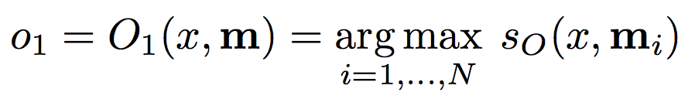
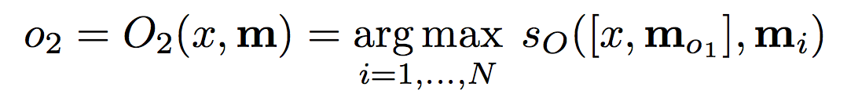
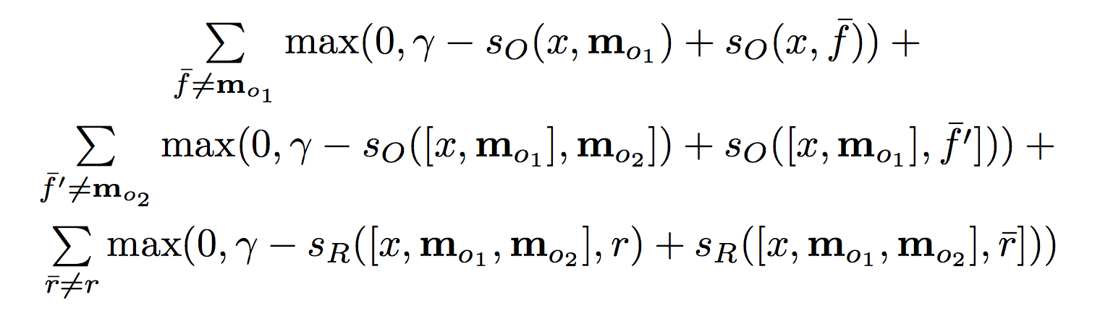
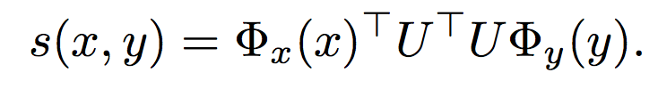
Goal – Study – Plan
Memory Network

Slide 17
Goal – Study – Plan
Training
Implementation
 | week1 | week2 | week3 | week4 | week5 | week6 | week7 | week8
Word embedding
Sequence embedding
Question Answering
Memory Network
Goal setting
Dataset
Implementation

